Slide 1

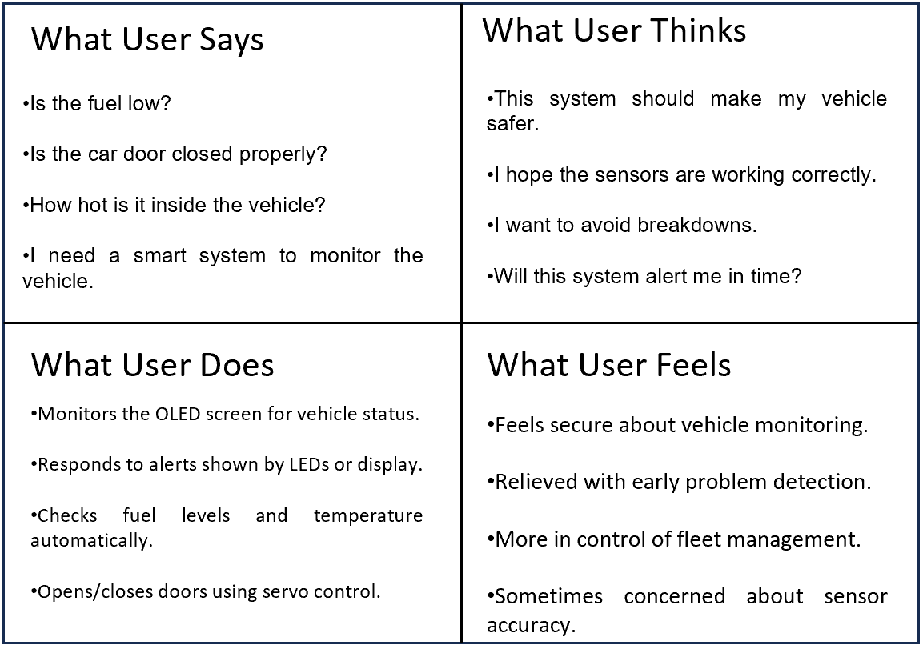
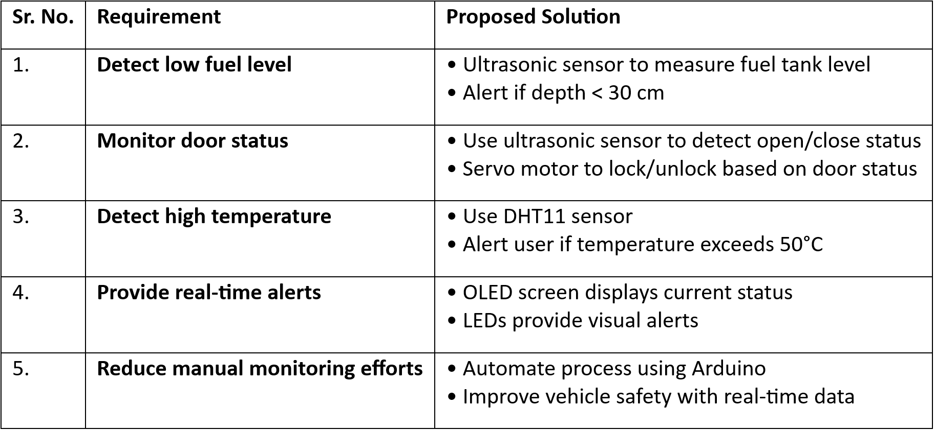
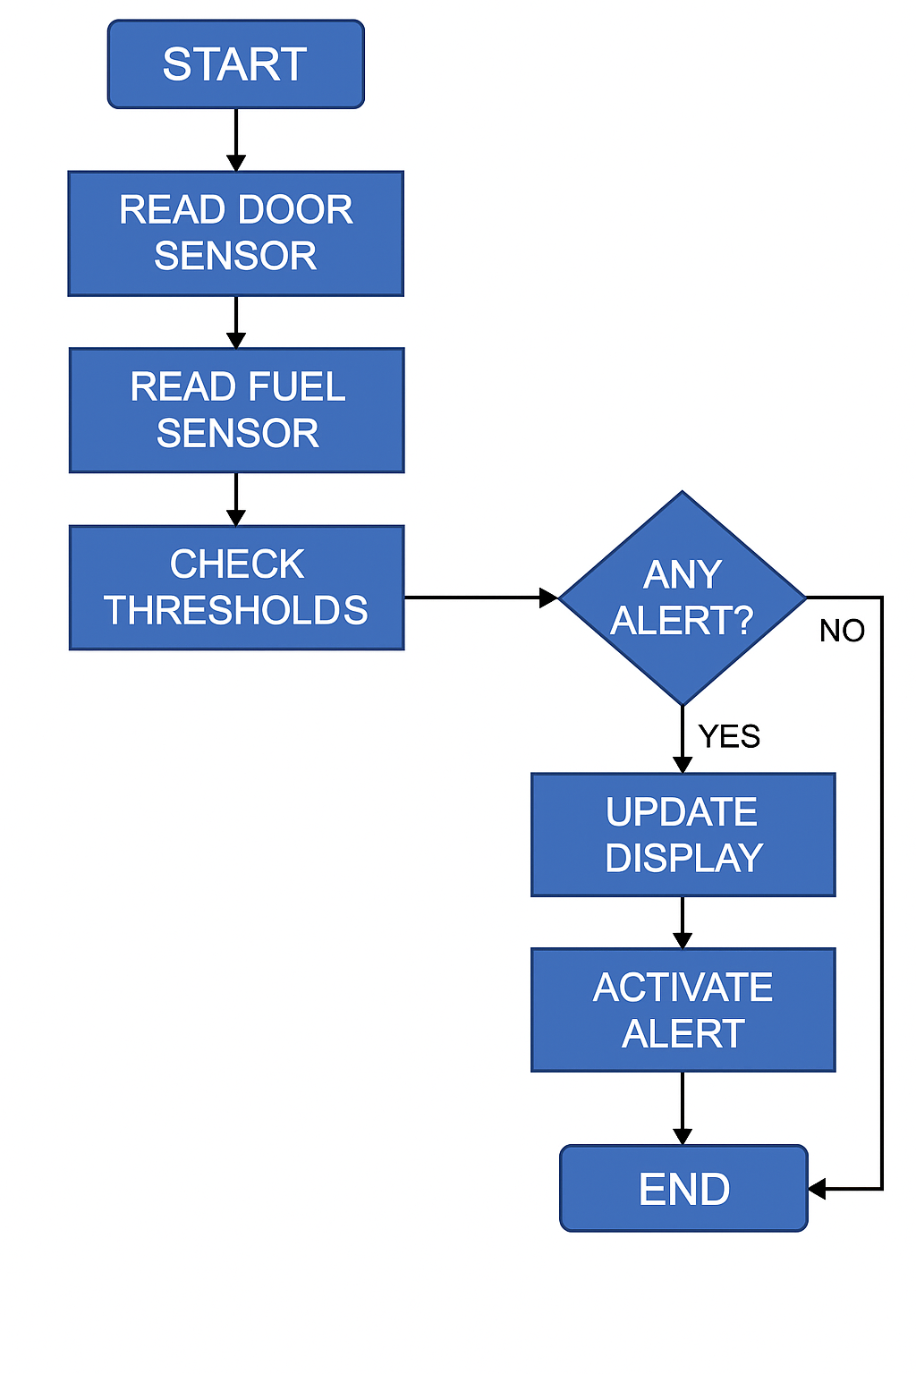
MIT SCHOOL OF COMPUTING
Class : TY AIA-3
Group Id: 10
DEPARTMENT OF COMPUTER SCIENCE & ENGINEERING
“ IOT IN FLEET MANAGMENT IN LOGISTICS ”
IoT based system for smart and efficient fleet condition monitoring
Tejas Raut, Shruti Thorat, Aditya Patil, Siddharth Dev, Swaroop Jadhav
Faculty Guide:
Dr. Chandrashekhar Kamargaonk
Proposed Architecture/ Diagram:
Problem statement
This project aims to develop a smart fleet management system using sensors to monitor critical vehicle parameters like fuel level, door status, and temperature. The goal is to enhance vehicle safety, reduce manual checks, and provide real-time alerts to ensure efficient and secure fleet operation.
Proposed Solution
A smart fleet management system using Arduino and sensors monitors fuel level, door status, and temperature. It provides real-time alerts via LEDs and OLED display, reducing manual checks and enhancing vehicle safety through automated monitoring.
Scope and Feasibility
The system is feasible using readily available components like Arduino, sensors, and displays. It can be implemented in various fleet types to improve safety and efficiency. The scope includes real-time monitoring, automated alerts, and potential future expansion with GPS and cloud integration.

